Slide 1
C++ Programming:
Problem Solving and Programming
Chapter 13
Files

Slide 2
Objectives
In this chapter you will:
Learn how to open and close a text file
Learn to use ifstream and ofstream
Explore how to read(input) data from a text file
Explore how to write (output) data to a text file

Slide 3
Text File
Text file is a named collection of characters saved in secondary storage (C, D or Pen drive)
Can use a file instead of keyboard for program
input
Can use a file instead of monitor screen for program output
Files are stored on secondary storage media, such as disk
Files allow data to be retained between program executions

Slide 4
Text File
Array and structure hold data temporarily where the data is gone once the program has completed its execution.
File can hold data permanently regardless of the program which refers to it, has finished its execution.
Normally use file extension “.dat” or “.txt”
Text file is created and located at the same folder as the program

Slide 5
fstream, ifstream and ofstream
C++ provides a header file called fstream, which is used for file I/O.
The fstream header file contains the definitions of two data types:
ifstream, which means input file stream and
ofstream, which means output file stream

Slide 6
File I/O (Input/Output)
5 steps process:
Step 1 - Include the header file fstream
    #include<fstream>
Step 2 - Declare file stream variables:
  ifstream inData;
  ofstream outData;

Slide 7
File I/O (Input/Output)
Step 3 – Opening files
Syntax:
fileStreamVariable.open(source,mode);
E.g. Open input file
inData.open(“A:inprog.dat");
Open output file
outData.open(“F:outprog.dat");
Note:
Input file must exist first.
Note:
New output file will be created or existing output file will be erased and replaced.

Slide 8
File I/O (Input/Output)
Step 4 - Use the file stream variables
with >>, << (Like cin>> and cout<<)
E.g. inData>>payrate; // read from file
outData<<pay; // write to file
Step 5 - Close the files
inData.close();
outData.close();
Note:
Don’t forget to close the file, the output data in the memory buffer waiting to be sent to the file could be lost.

Slide 9
File I/O (Input/Output)
Why is closing a file an important step?
  Most operating systems temporarily store data in a file buffer before it is written to a file. A file buffer is a small ‘holding section’ of memory that file-bound data is first written to. The data is not actually written to the file until the buffer is full. Closing a file causes any unsaved data still in a buffer to be written out to its file. This ensures that all the data the program intended to write to the file is actually in it.
  Some operating systems limit the number of files that may be opened at one time. When a program closes files that are no longer being used, it will not deplete more of the operating system’s resources than necessary.
AACS2524 Programming Concepts

Slide 10
Checking file opening error
File opening error happen when file is not found, file corrupted, or some other reasons
E.g.
if ( !inData ) // if infile can’t be opened, use ‘!’
{ // OR use if ( inData.fail() )
cout<<"Error opening file";
return 1; // exit the program
}

Slide 11
Using loop to read data from file
A Loop can be used to read each piece of data from a file
It is not necessary to know how much data is in the file
Several methods exist to test for the end of the file

Slide 12
eof( ) function
Used during reading the file to check if the end-of-file is reached
eof() returns true when the read encounters the end of file, otherwise returns false
For the eof() function to work correctly using this method, there must be a whitespace (space, tab, or [Enter] ) after the last piece of data
Otherwise the end of file will be encountered when reading the final data value and it will not be processed

Slide 13
Example of reading a file
E.g.
infile.get(num); // read an integer from file
while ( !infile.eof() ) { // check end of file status
cout << num;
infile.get(num); // read next integer from file
}

Slide 14
Example of getting array data from a file
const int ISIZE = 5, sales[ISIZE];
ifstream dataFile;
dataFile.open("sales.dat");
if (!dataFile)
cout << "Error opening data file\n";
else
{
// Input daily sales
for (int day = 0; day < ISIZE; day++)
dataFile >> sales[day];
dataFile.close();
}

Slide 15
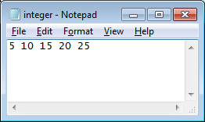
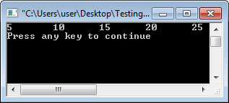
Text file - Example
#include<iostream>
#include <fstream> // add file stream header file
using namespace std;
void main( ) {
ifstream inData; // declare file stream variable
int integer;
inData.open("integer.dat"); // open input file
if (!inData) { // check for file opening error
cout<<"Error opening file";
return 1; // exit the program
}
inData>>integer; // read an integer from file
while (!inData.eof()) { // check for eof
cout<<integer<<"\t";
inData>>integer; // read next integer
}
inData.close(); // close file
}
AACS2524 Programming Concepts

Slide 16
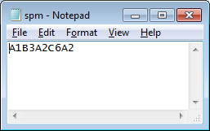
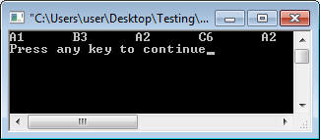
Text file - Example
#include<iostream>
#include <fstream>
using namespace std;
int main() {
ifstream infile;
char ch; int integer;
infile.open("spm.dat");
if (!infile) {
cout<<"Error opening file";
return 1;
}
infile>>ch>>integer;
while (!infile.eof()) {
cout<<ch<<integer<<"\t";
infile>>ch>>integer;
}
infile.close();
}
AACS2524 Programming Concepts

Slide 17
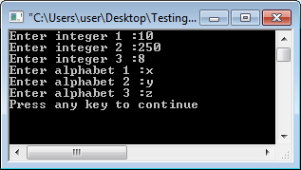
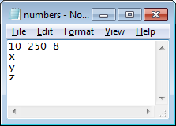
Text file - Example
Text file - Example
void main() {
int i, x; char y;
ofstream outFile;
outFile.open("numbers.dat“);
if (!outFile) {
cout<<"Error opening file";
return 1;
}
for(i=1;i<=3;i++) {
cout<<"Enter integer "<<i<<“ :”;
cin>>x;
outFile<<x<<" ";
}
outFile<<"\n";
for(i=1;i<=3;i++) {
cout<<"Enter alphabet "<<i<<“ :”;
cin>>y;
outFile<<y<<"\n";
}
outFile.close();
}
AACS2524 Programming Concepts

Slide 18
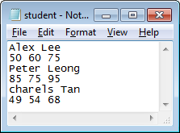
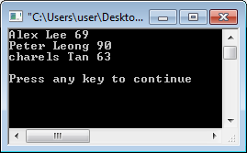
void main() {
char name[20], ch;
int cw, prac, exam, final;
ifstream infile;
infile.open(“student.dat“);
if (!infile) {
cout<<"Error opening file"; return 1;
}
infile.get(name,21); // read including ”\n"
infile>>cw>>pract>>exam; // ”\n" left behind
infile.get(ch); // read ”\n"
final = 0.15*cw+0.15*pract+0.7*exam;
cout<<name<<" "<<final<<endl;
while (!infile.eof()) {
infile.get(name,21);
infile>>cw>>pract>>exam;
infile.get(ch);
final = 0.15*cw+0.15*pract+0.7*exam;
cout<<name<<" "<<final<<endl; }
infile.close(); }
Text file - Example
Text file - Example
AACS2524 Programming Concepts

Slide 19
Binary Files
Binary files are a little bit more complicated, but they are still rather simple.
We do not use the insertion and extraction operators.
Must use the methods read() and write() for binary.
To create a binary file:
ofstream fout("file.dat", ios::binary);

Slide 20
Binary Files – Write & Read
Open the file as binary
write() & read() method takes two parameters:
  The first is a char pointer to the object you wish to write,
  The second is the number of bytes the object is.
Example:
int number = 30;
fout.write(reinterpret_cast<char*>(&number),sizeof(number));
fin.read(reinterpret_cast<char *> (&number), sizeof(number));

Slide 21
Binary Files – Write & Read
The first parameter is written as
"reinterpret_cast<char*>(&number)"
This just type casts the integer variable to a char pointer.
The second parameter was written as "sizeof(number)". The sizeof() function just returns an integer of the number of bytes a variable is.

Slide 22
Binary Files – Sample Program
#include <iostream>
#include <fstream>
#include <cstring>
using namespace std;
typedef struct
{ char gender;
int age;
string name;
} person;
int main(){
person people;
people.name= "Ali";
people.age= 22;
people.gender= 'm';
ofstream output;
output.open("indata.dat", ios::out|ios::binary);
output.write(reinterpret_cast<char *>(&people),
sizeof(people) );
output.close();
person newperson;
ifstream input;
input.open("indata.dat", ios::in|ios::binary);
input.read(reinterpret_cast<char *>
(&newperson), sizeof(person) );
cout << "\n Name is ==> " << newperson.name;
cout << "\n Gender is ==> "
<< newperson.gender;
cout << "\n Age is ==> " << newperson.age;
input.close();
return 0;
}

